Slide 1
Overlearning, Choking, the Einstellung Effect, and Interleaving
By Barbara Oakley, PhD

Slide 2
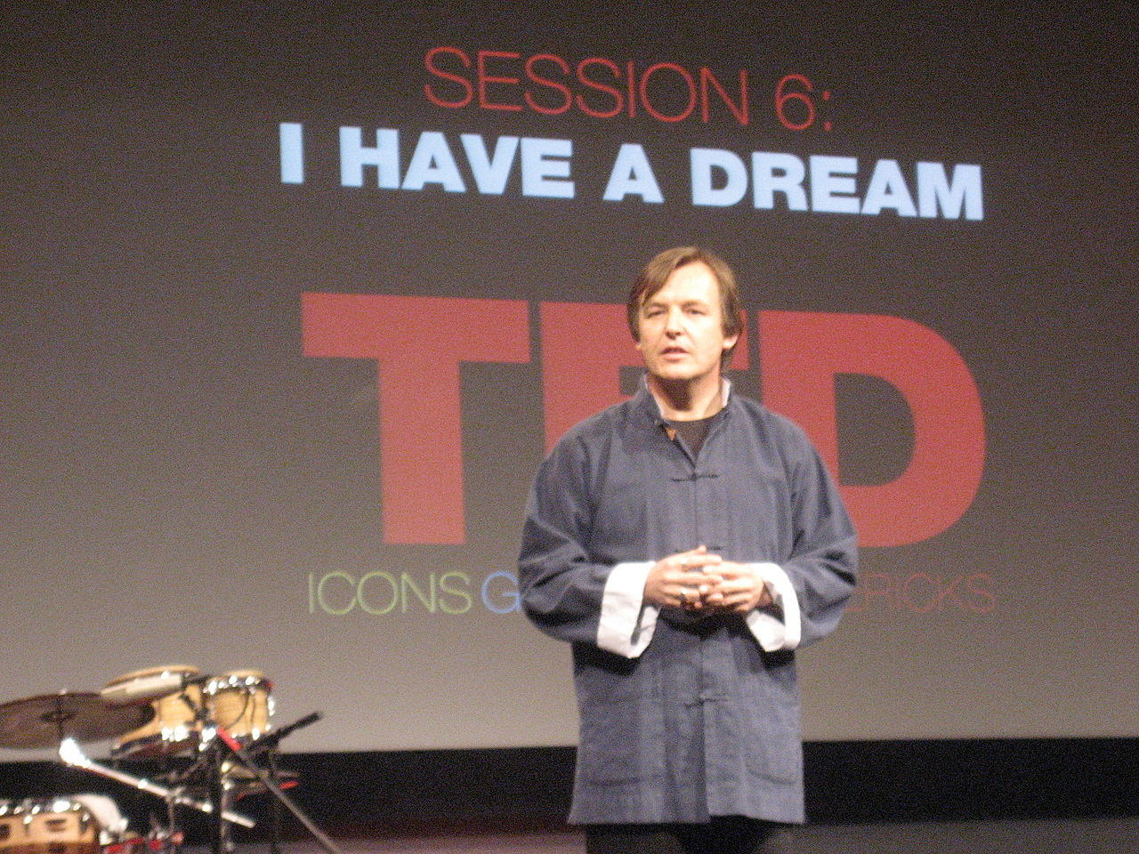
Overlearning

Slide 3
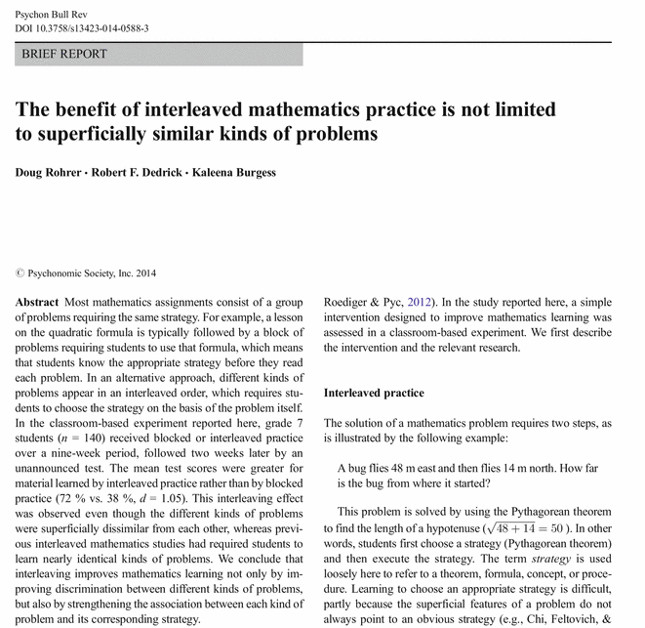

Slide 4
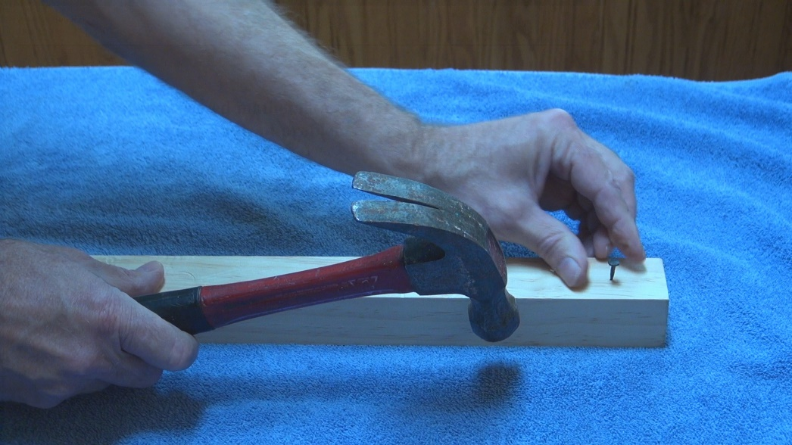
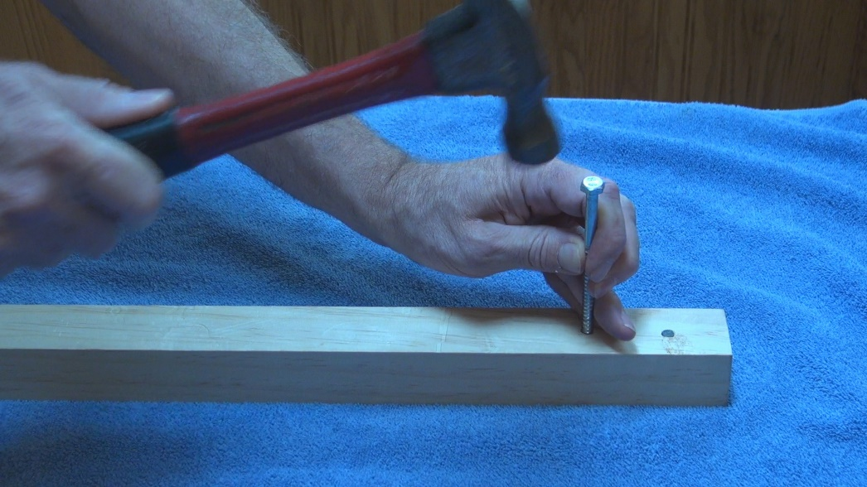

Slide 5
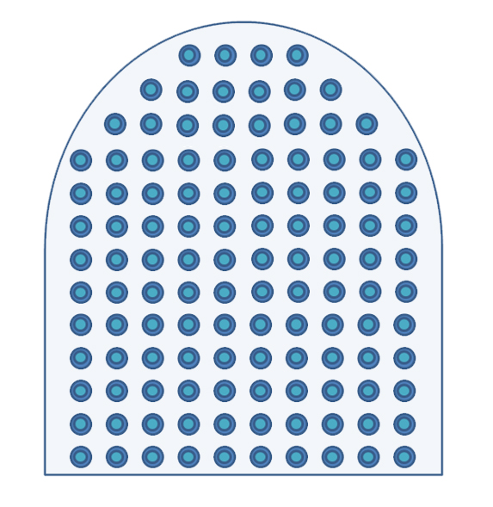
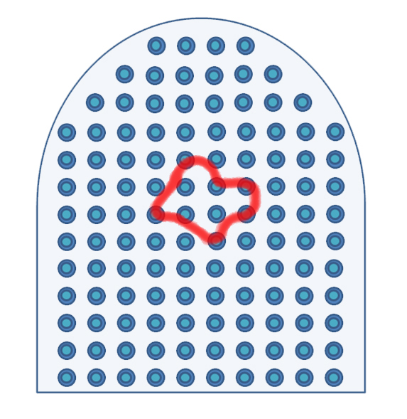

Slide 6
Illusion of competence
(versus)
Deliberate practice

Slide 7
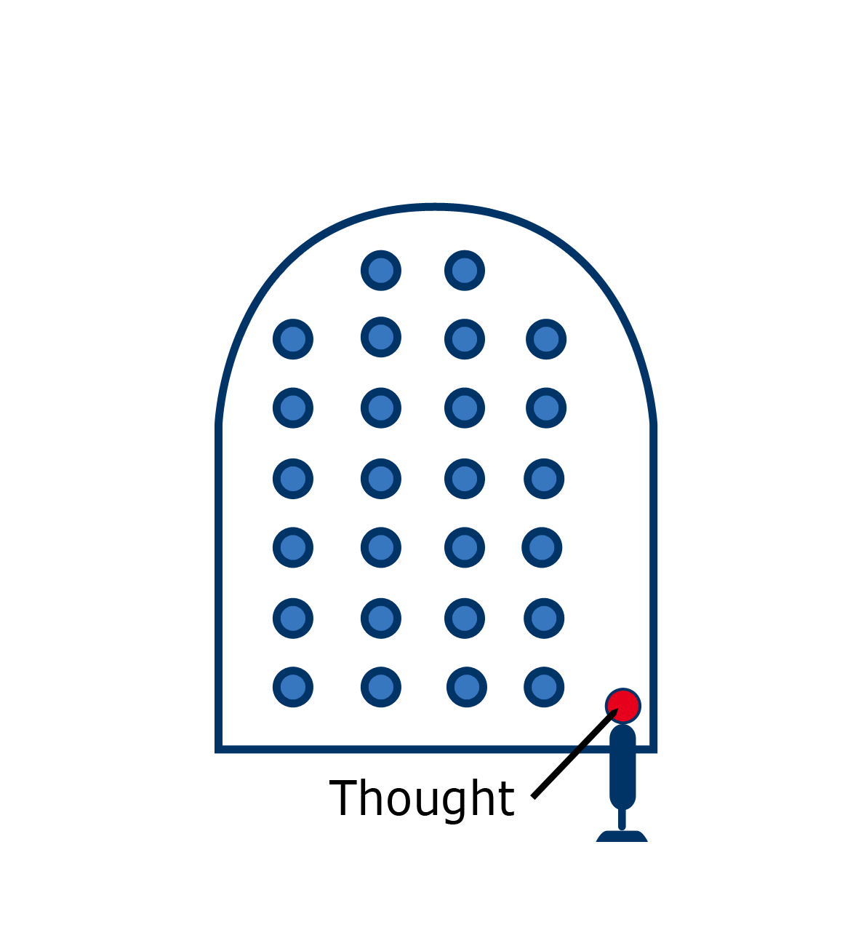
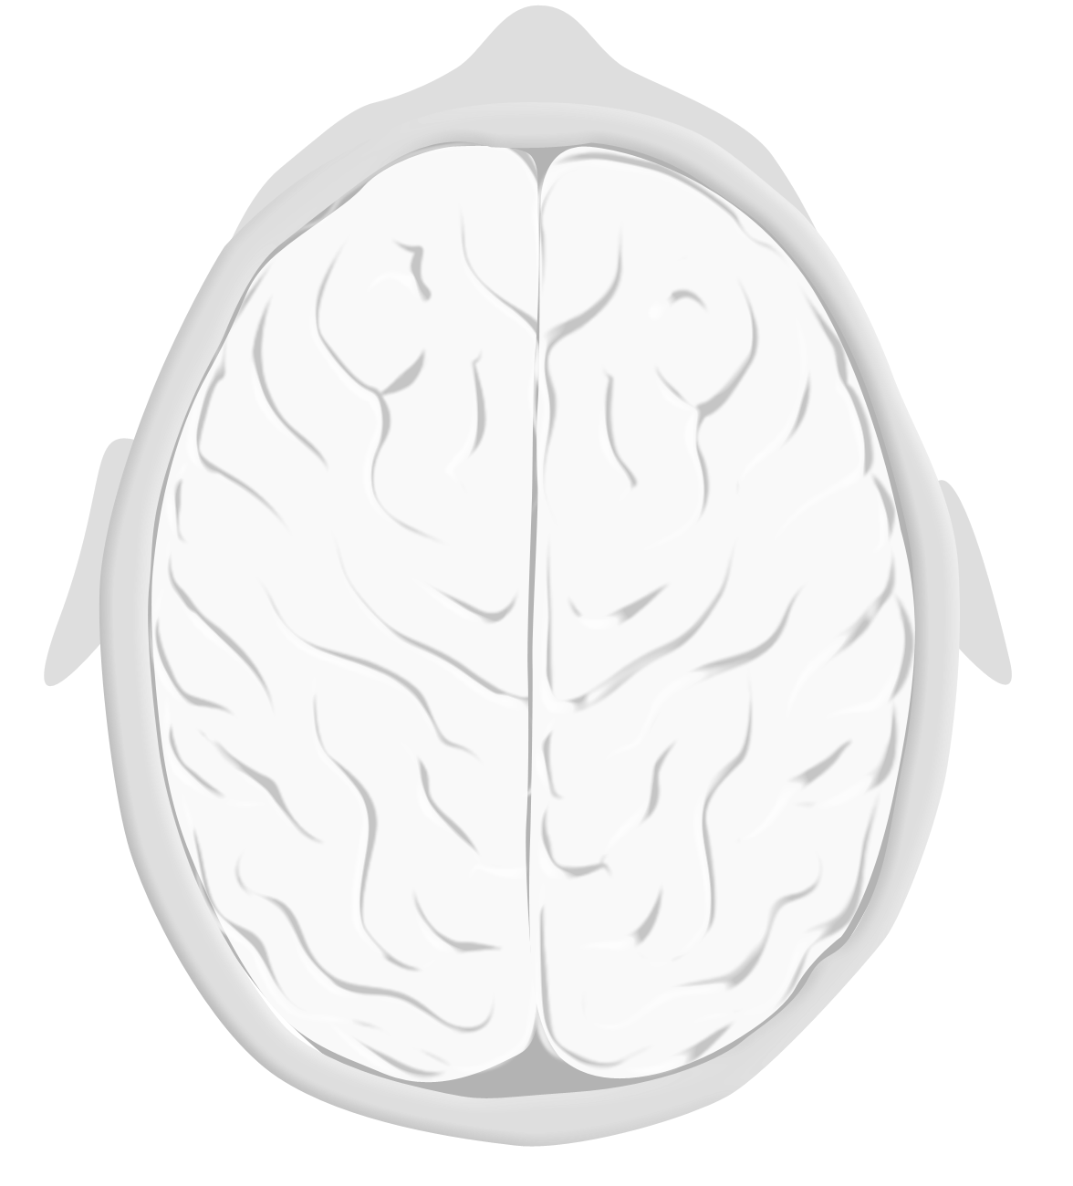

Einstellung
= Installation

Slide 8
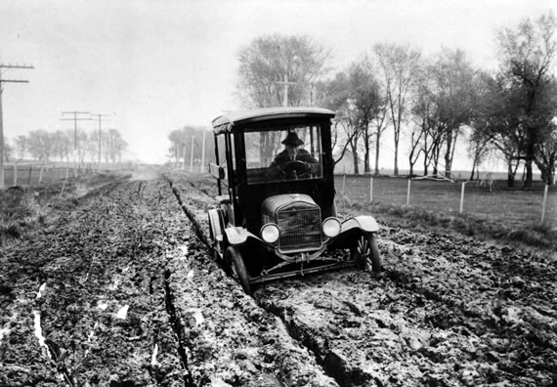

Slide 9
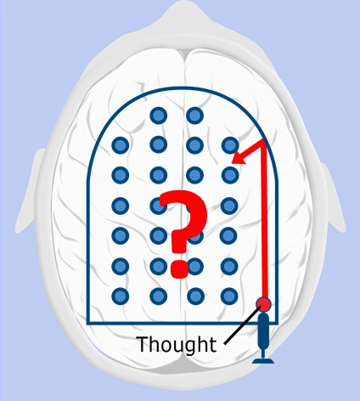

Slide 10
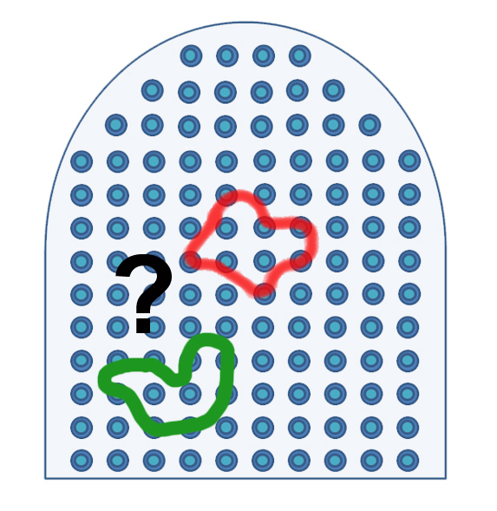

Slide 11
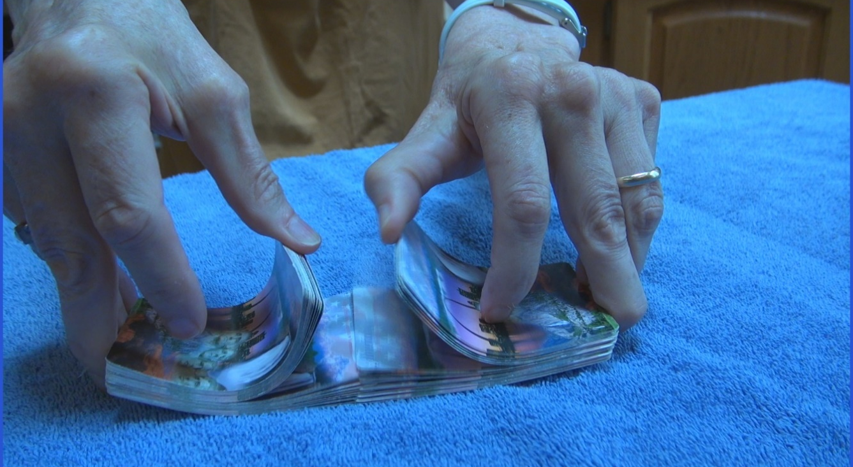
Interleaving

Slide 12
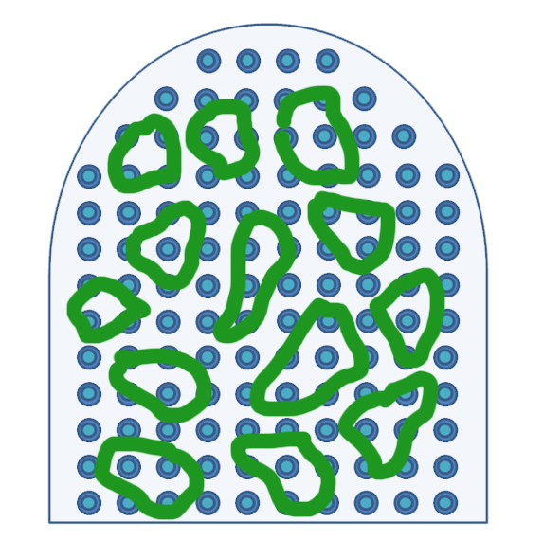
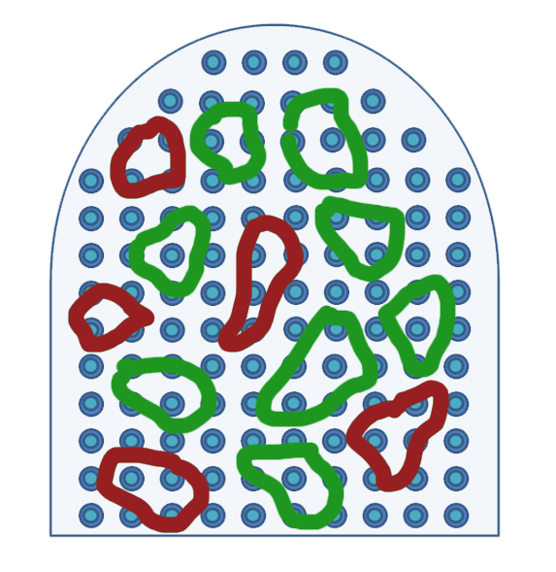


Slide 13


The Structure of
Scientific Revolutions
Thomas S. Kuhn

Slide 14




Slide 15
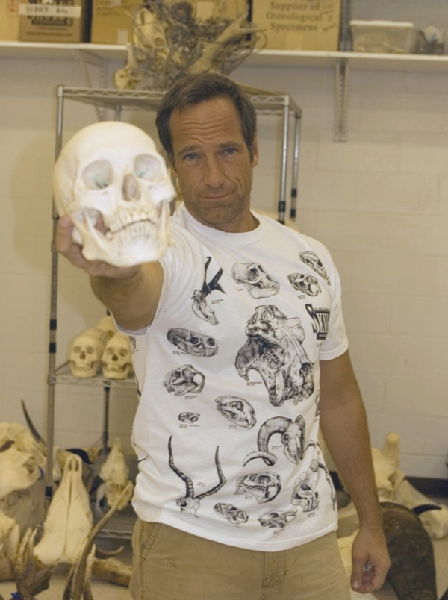

Slide 16
Relevant Readings
Beilock, S. (2010). Choke. NY: Free Press.
Bilalic, M., McLeod, P., & Gobet, F. (2008). Inflexibility of experts--reality or myth? Quantifying the Einstellung effect in chess masters. Cognitive psychology, 56(2), 73-102. doi: 10.1016/j.cogpsych.2007.02.001
Bilalić, M., McLeod, P., & Gobet, F. (2008). Why good thoughts block better ones: The mechanism of the pernicious Einstellung (set) effect. Cognition, 108(3), 652-661. doi: 10.1016/j.cognition.2008.05.005
Carey, B. (2012). Cognitive science meets pre-algebra. New York Times, Sep 2. http://www.nytimes.com/2013/09/03/science/cognitive-science-meets-pre-algebra.html?ref=science.
Duarte, N. (2012). HBR Guide to Persuasive Presentations: Harvard Business Review Press.
Feynman, R. (1985). "Surely You're Joking, Mr. Feynman". NY: W. W. Norton.
Geary, D. C. (2011). Primal brain in the modern classroom. Scientific American Mind, 22(4), 44-49.
Kuhn, T. (1962). The Structure of Scientific Revolutions (2nd (1970) ed.). Chicago, IL: University of Chicago Press.
Luchins, A. S. (1942). Mechanization in problem solving: The effect of Einstellung. Psychol Monogr, 54(6), 1-95.
Pachman, M., Sweller, J., & Kalyuga, S. (2013). Levels of knowledge and deliberate practice. Journal of experimental psychology, 19(2), 108-119.
Roediger, H. L., & Pyc, M. A. (2012). Inexpensive techniques to improve education: Applying cognitive psychology to enhance educational practice. Journal of Applied Research in Memory and Cognition, 1(4), 242-248. doi: 10.1016/j.jarmac.2012.09.002
Rohrer, D., & Pashler, H. (2007). Increasing retention without increasing study time. Current Directions in Psychological Science, 16(4), 183-186.
Rohrer, D., & Pashler, H. (2010). Recent research on human learning challenges conventional instructional strategies. Educational Researcher, 39(5), 406-412.
Rohrer, D., et al. (2014). "The benefit of interleaved mathematics practice is not limited to superficially similar kinds of problems." Psychonomic Bulletin & Review: 1-8.
Schoenfeld, A. H. (1992). Learning to think mathematically: Problem solving, metacognition, and sense-making in mathematics. In D. Grouws (Ed.), Handbook for Research on Mathematics Teaching and Learning. NY: MacMillan.
Taylor, K., & Rohrer, D. (2010). The effects of interleaved practice. Applied Cognitive Psychology, 24(6), 837-848.
Image Credits
Car in Muddy Road Rut, ca. 1920, Photo courtesy of the Iowa Department of Transportation http://www.iptv.org/iowapathways/artifact_detail_large.cfm?aid=a_000232&oid=ob_000220
TED (Technology, Entertainment, Design) Conference Curator Chris Anderson in 2007. Pierre Omidyar - Flickr, http://en.wikipedia.org/wiki/TED_(conference)#mediaviewer/File:Chris_Anderson_2007.jpg
Rohrer, D., et al. (2014). "The benefit of interleaved mathematics practice is not limited to superficially similar kinds of problems." Psychonomic Bulletin & Review: 1-8.
Hammering, ©Philip Oakley, 2014.
Neural chunks ©Barbara Oakley, 2014.
Neural patterns ©Kevin Mendez, 2014.
Mike Rowe, http://en.wikipedia.org/wiki/Mike_Rowe#mediaviewer/File:Dirty_Jobs_small.jpg, by Sklmsta
Clip art courtesy Microsoft Corporation

